Slide 1

CSCI/ARTI 8950 Machine Learning
Lecture Notes 8: Linear Models
Khaled Rasheed
Professor
School of Computing
Member
Institute for Artificial Intelligence
University of Georgia
Credit: some examples & figures by Marine Carpuat, Tom Mitchell and Hal Daumé III

Slide 2
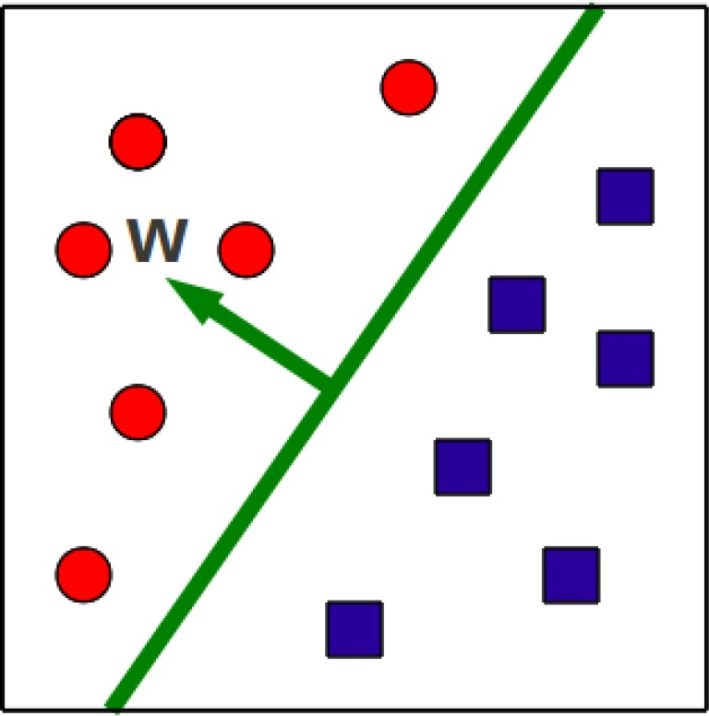
Binary classification via hyperplanes
A classifier is a hyperplane (w,b)
At test time, we check on what side of the hyperplane examples fall
𝑦 = 𝑠𝑖𝑔𝑛(𝑤^{𝑇}𝑥 + 𝑏)
This is a linear classifier
– Because the prediction is a linear combination of feature values x

Slide 3
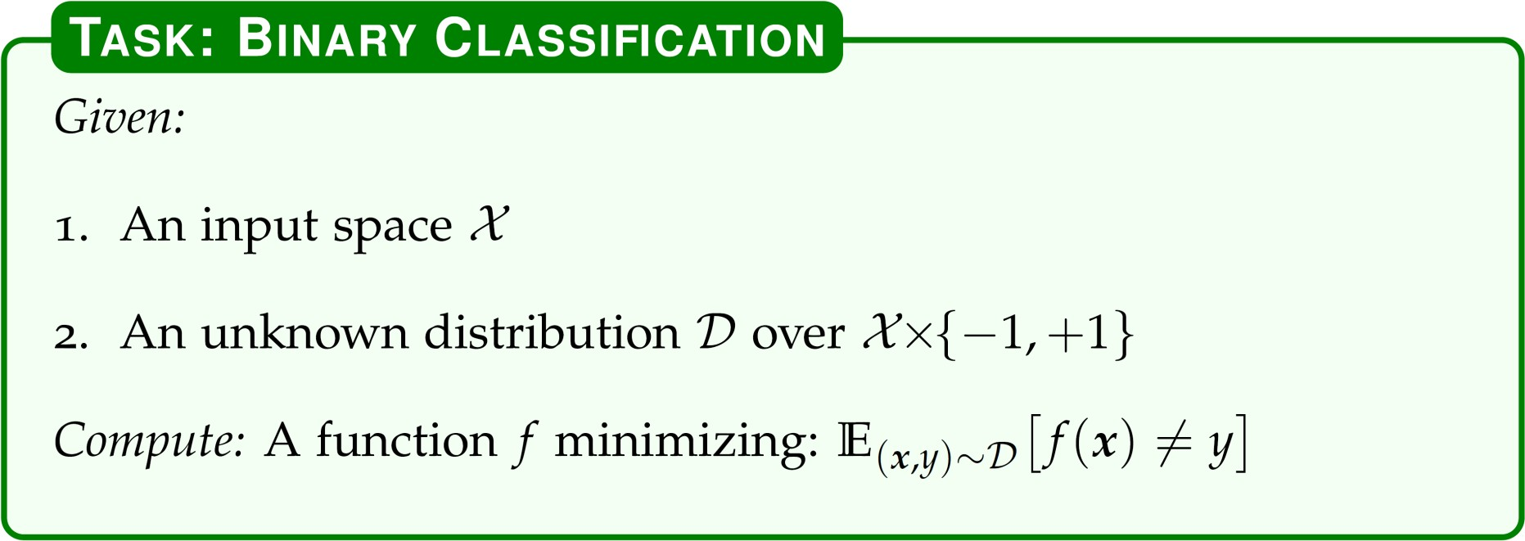

Slide 4
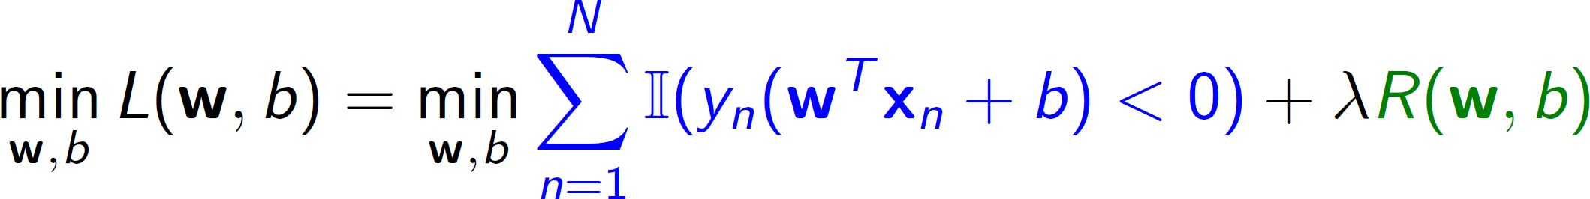

Learning a Linear Classifier as an Optimization Problem
Loss function measures how well classifier fits training data
Regularizer prefers solutions that generalize well
Objective function
Indicator function: 1 if (.) is true, 0 otherwise
The loss function above is called the 0-1 loss

Slide 5
Casting Linear Classification as an Optimization Problem
Loss function measures how well classifier fits training data
Regularizer prefers solutions that generalize well
Objective function
Indicator function: 1 if (.) is true, 0 otherwise The loss function above is called the 0-1 loss

Slide 6
Learning a Linear Classifier as an Optimization Problem
Problem: The 0-1 loss above is NP-hard to optimize
exactly/approximately in general
Solution: Different loss function approximations and regularizers lead to specific algorithms
(e.g., perceptron, support vector machines, logistic regression, etc.)

Slide 7
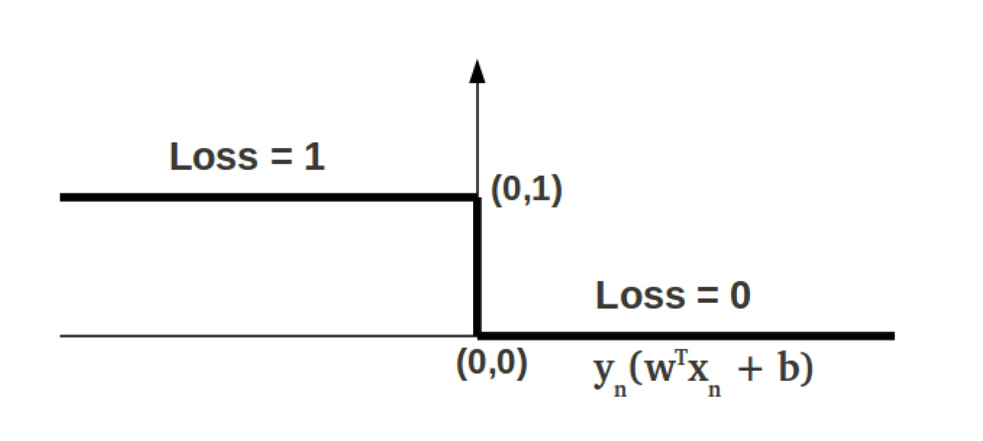
The 0-1 Loss
Small changes in w,b can lead to big changes in the loss value
0-1 loss is non-smooth, non-convex

Slide 8
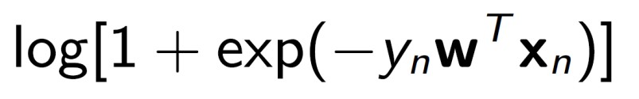
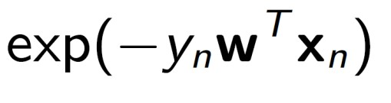
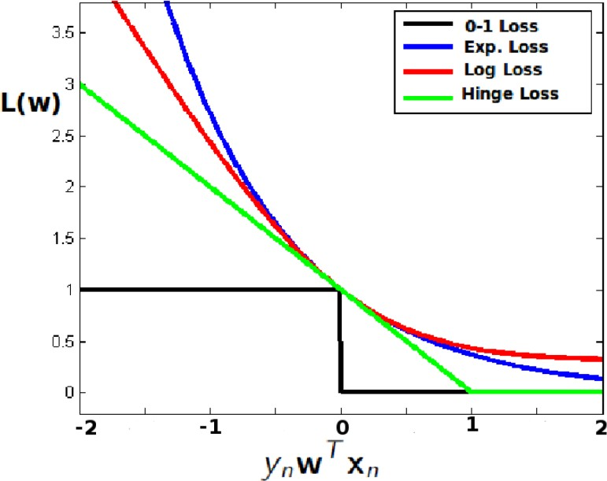
Approximating the 0-1 loss with surrogate loss functions
Examples (with b = 0)
Hinge loss
Log loss
Exponential loss
All are convex upper- bounds on the 0-1 loss

Slide 9
Approximating the 0-1 loss with surrogate loss functions
Examples (with b = 0)
Hinge loss
Log loss
Exponential loss
Q: Which of these loss functions is not smooth?

Slide 10
Approximating the 0-1 loss with surrogate loss functions
Examples (with b = 0)
Hinge loss
Log loss
Exponential loss
Q: Which of these loss functions is most sensitive to outliers?

Slide 11
Casting Linear Classification as an Optimization Problem
Loss function measures how well classifier fits training data
Regularizer prefers solutions that generalize well
Objective function
Indicator function: 1 if (.) is true, 0 otherwise The loss function above is called the 0-1 loss

Slide 12
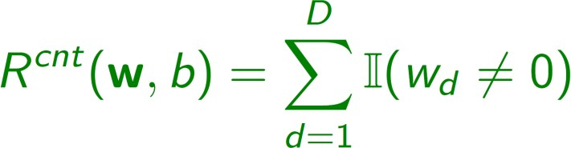
The regularizer term
Goal: find simple solutions (inductive bias)
Ideally, we want most entries of w to be zero, so prediction depends only on a small number of features.
Formally, we want to minimize:
That’s NP-hard, so we use approximations instead.
– E.g., we encourage w_{d}’s to be small

Slide 13
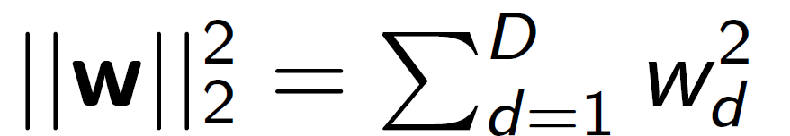
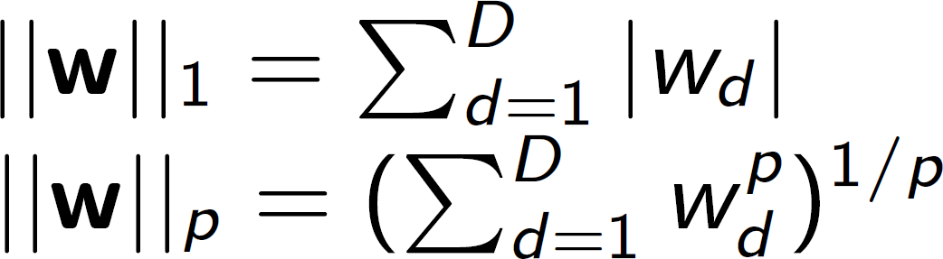
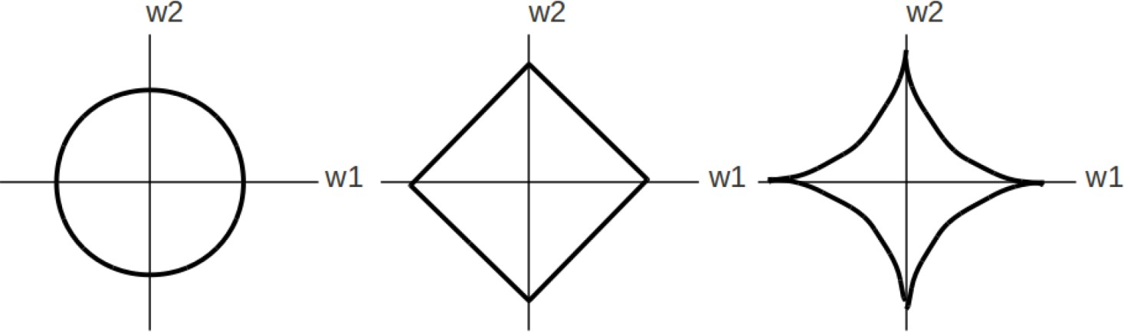
Norm-based Regularizers
𝑙_{𝑝} norms can be used as regularizers
Contour plots for
p = 2
p = 1
p < 1

Slide 14
Norm-based Regularizers
𝑙_{𝑝} norms can be used as regularizers
Smaller p favors sparse vectors w
– i.e. most entries of w are close or equal to 0
𝑙₂ norm: convex, smooth, easy to optimize
𝑙₁ norm: encourages sparse w, convex, but not smooth at axis points
𝑝 < 1 : norm becomes non convex and hard to optimize

Slide 15
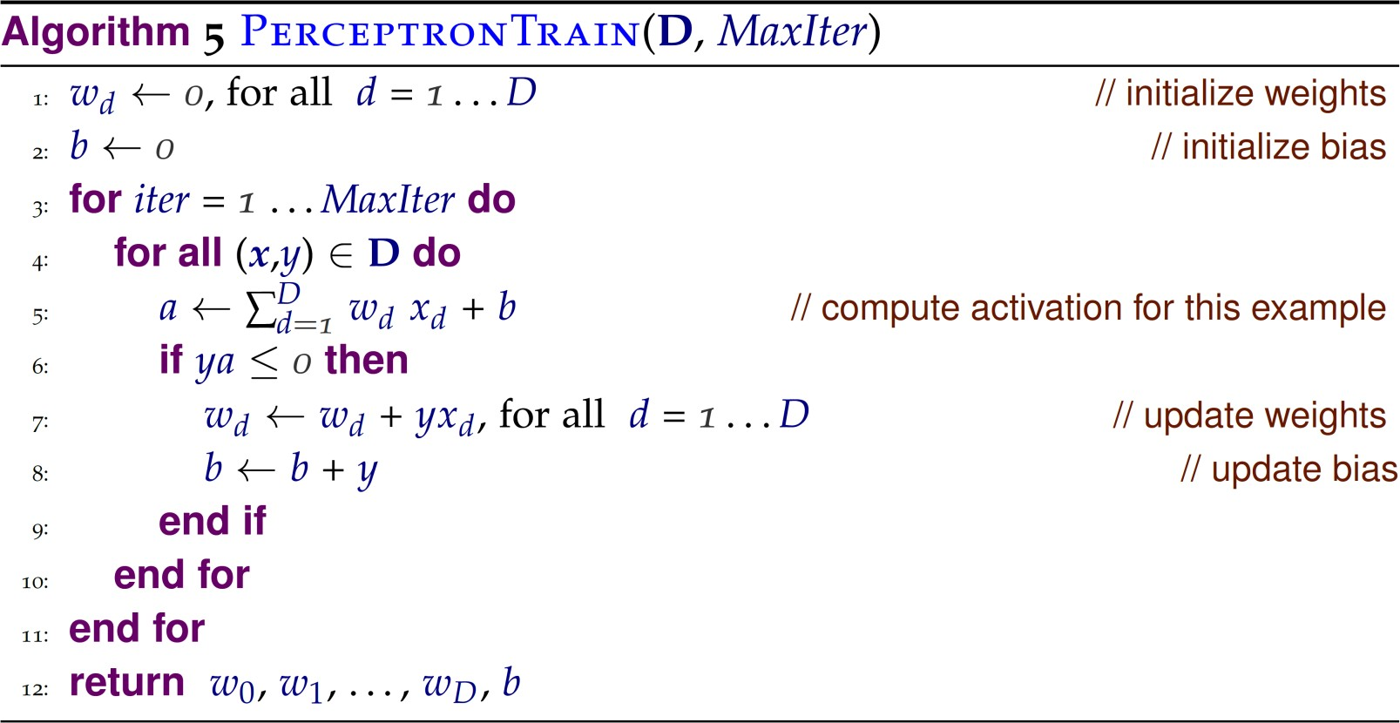

What is the perceptron optimizing?
Loss function is a variant of the hinge loss

Slide 16
Casting Linear Classification as an Optimization Problem
Loss function measures how well classifier fits training data
Regularizer prefers solutions that generalize well
Objective function
Indicator function: 1 if (.) is true, 0 otherwise The loss function above is called the 0-1 loss

Slide 17
Recap: Linear Models
General framework for binary classification
Cast learning as optimization problem
Optimization objective combines 2 terms
loss function: measures how well classifier fits training data
Regularizer: measures how simple classifier is
Does not assume data is linearly separable
Lets us separate model definition from training algorithm (Gradient Descent)

Slide 18
Gradient descent
A general solution for our optimization problem
Idea: take iterative steps to update parameters in the direction of the gradient

Slide 19
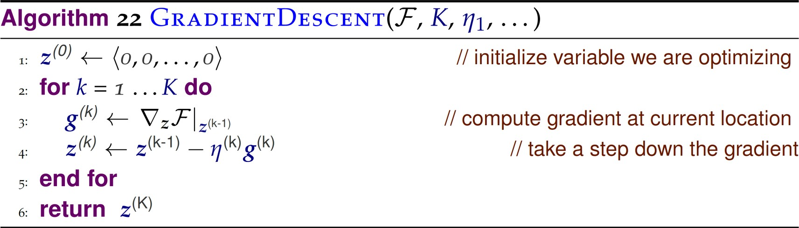
Gradient descent algorithm
Objective function to minimize
Number of steps
Step size

Slide 20
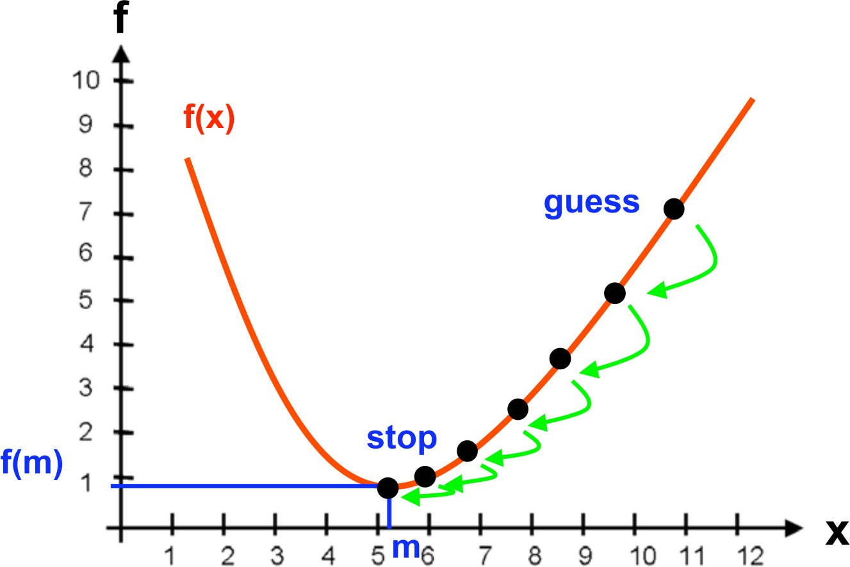
Illustrating gradient descent in 1-dimensional case

Slide 21
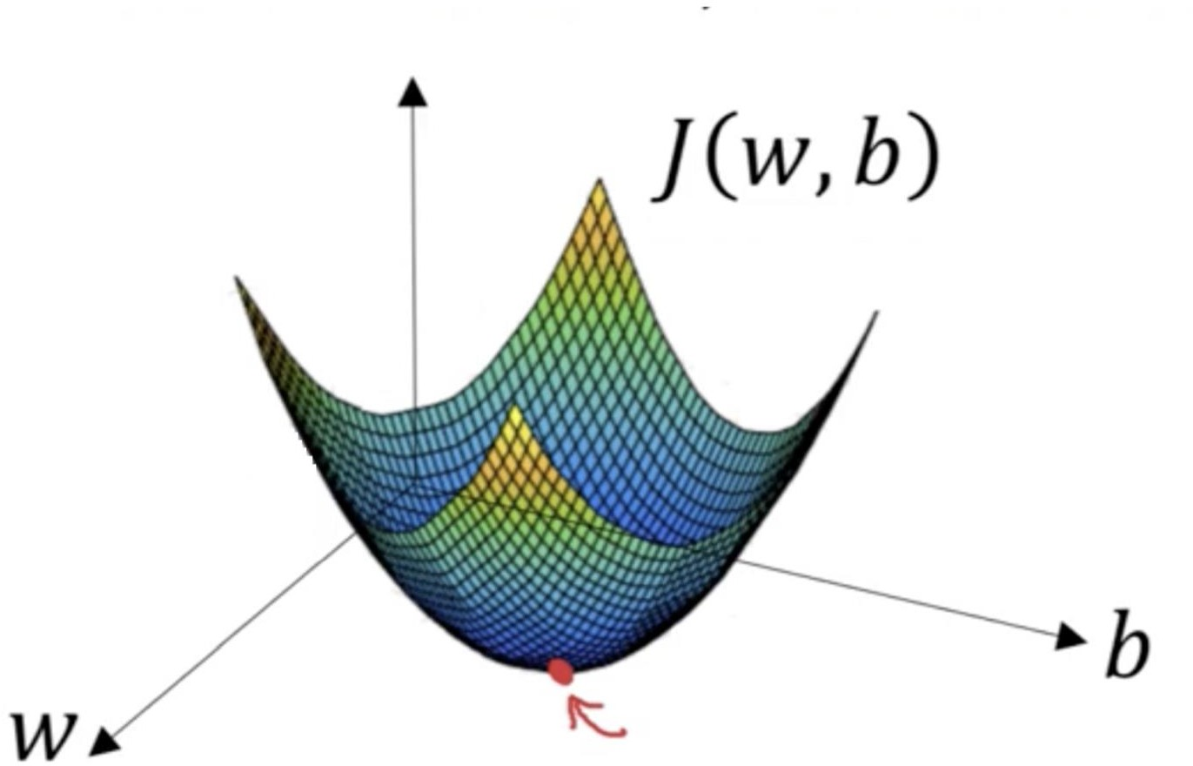
Illustrating gradient descent in 2-dimensional case
F(w,b)
Image source: https://builtin.com/data-science/gradient-descent

Slide 22
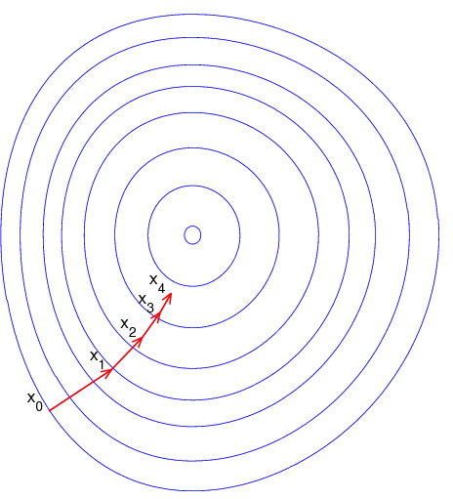
Illustrating gradient descent in 2-dimensional case
Image source: https://builtin.com/data-science/gradient-descent

Slide 23
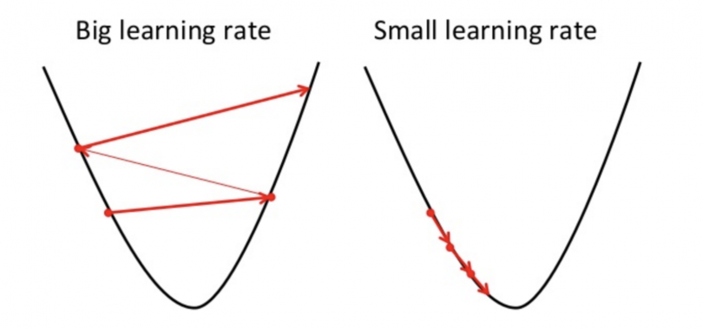
Impact of the step size
Image source: https://builtin.com/data-science/gradient-descent

Slide 24
Gradient descent algorithm
Objective function to minimize
Number of steps
Step size

Slide 25
Gradient Descent
2 questions
When to stop?
When the gradient gets close to zero
When the objective stops changing much
When the parameters stop changing much
Early: When performance on held-out dev set plateaus
How to choose the step size?
Start with large steps, then take smaller steps

Slide 26
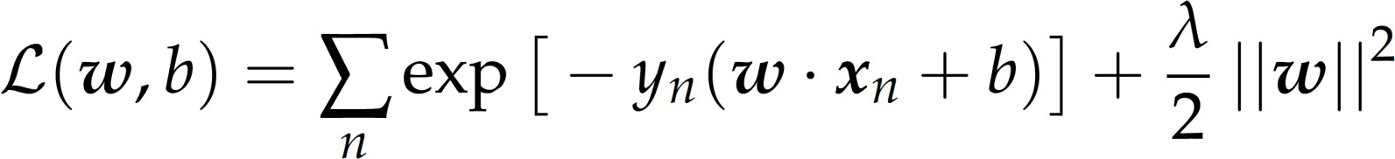
Now let’s calculate gradients for multivariate objectives
Consider the following learning objective
What do we need to do to run gradient descent?

Slide 27
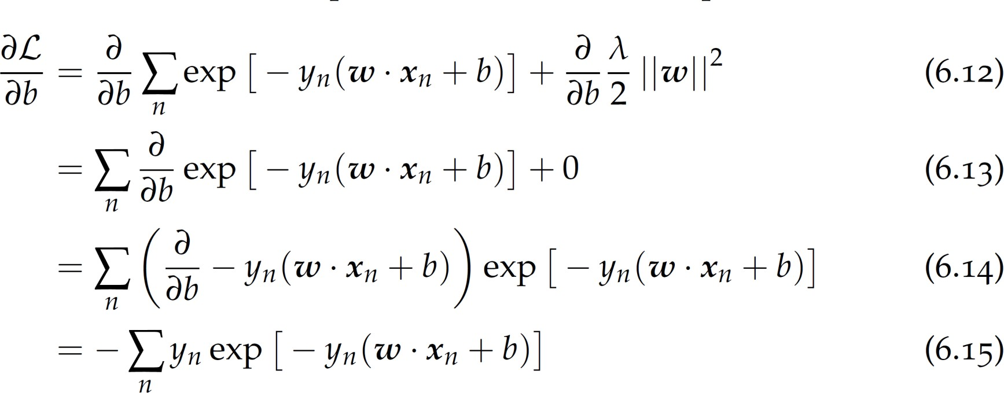
(1) Derivative with respect to b

Slide 28
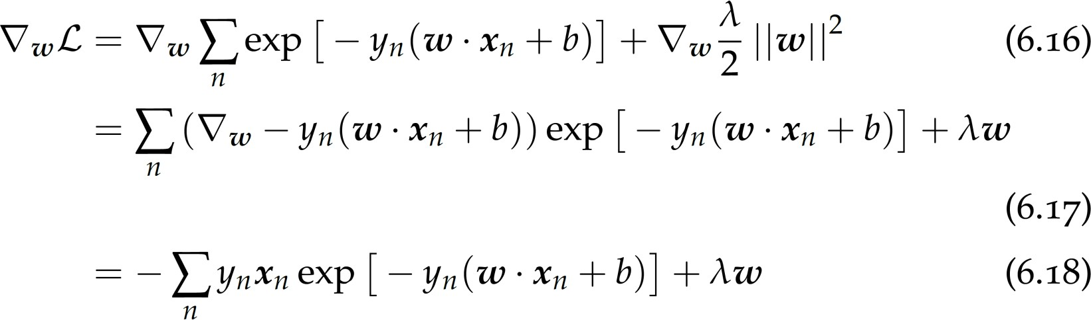
(2) Gradient with respect to w

Slide 29
Subgradients
Problem: some objective functions are not differentiable everywhere
Hinge loss, l1 norm
Solution: subgradient optimization
Let’s ignore the problem, and just try to apply gradient descent anyway!!
we will just differentiate by parts…

Slide 30
Example: subgradient of
hinge loss
For a given example n

Slide 31
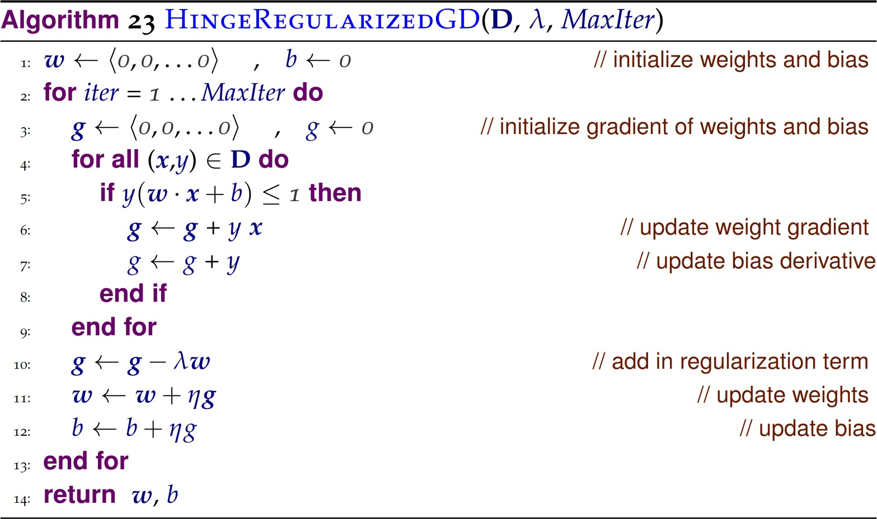
Subgradient Descent for Hinge Loss

Slide 32

Linear Regression (1)
Given a dataset
where
In the simple case that each sample has only one attribute (i.e.,
d = 1), linear regression aims to learn the following function:
such that
How to determine the parameters w and b ?
We will use the square loss!

Slide 33
Linear Regression (2)
In the simple case with only one attribute (i.e., d= 1), linear regression aims to learn the following function:
We can minimize the loss function using squared loss:
Calculate the derivative of and and let them equal to 0.

Slide 34
Linear Regression (3)
In the general case with multiple attribute (i.e., d> 1), linear regression aims to learn the following function:
For simplicity, we define = [w,b]^{T}, represent dataset 2 as a matrix X of size m×(d + 1),
and represent in vector form:

Slide 35
Linear Regression (4)
We now optimize the following problem:
Let the loss function We obtain the derivative w.r.t. as:
If is a full rank matrix or positive definite matrix, the solution to above problem is:

Slide 36
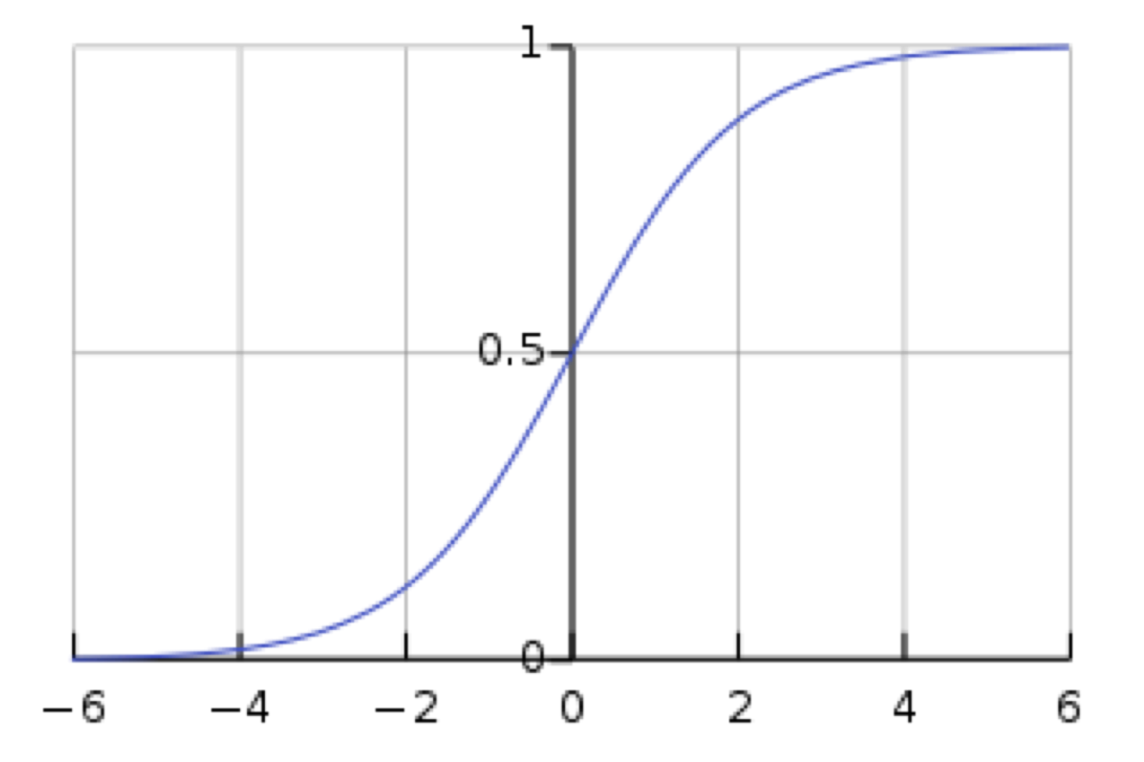
Logistic Regression: General Idea
Key Idea: Turns linear predictions into probabilities
Sigmoid function:
Projects (−∞, +∞) to [0, 1]
Compare to linear probability model
More smooth
Logistic Regression Model
Linear Probability Model

Slide 37
Logistic Regression: Maximum Likelihood
The prediction function to learn
Maximum Likelihood
Log likelihood:
Optimization: Gradient Descent
Note that Logistic Regression is actually a classification method (not really regression)!

Slide 38
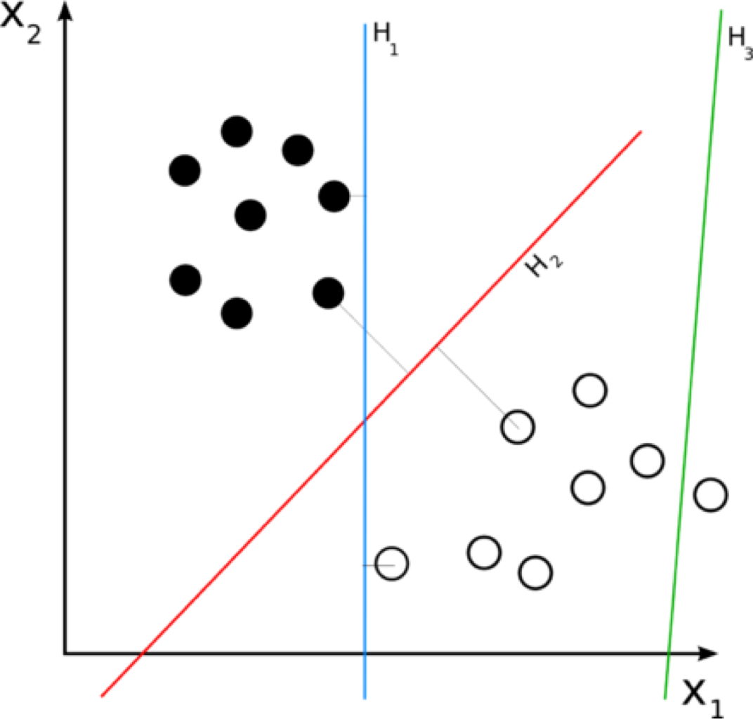
Which Line is Better?
There might be many feasible linear functions
Both H1 and H2 will work
Which one is better?
H2 looks “better” in the sense that it is also furthest from both groups

Slide 39

Support Vector Machines (SVM): Motivation
Which hyperplane to choose?
SVM finds this hyperplane using support vectors (“essential” training tuples) and margins (defined by the support vectors)

Slide 40
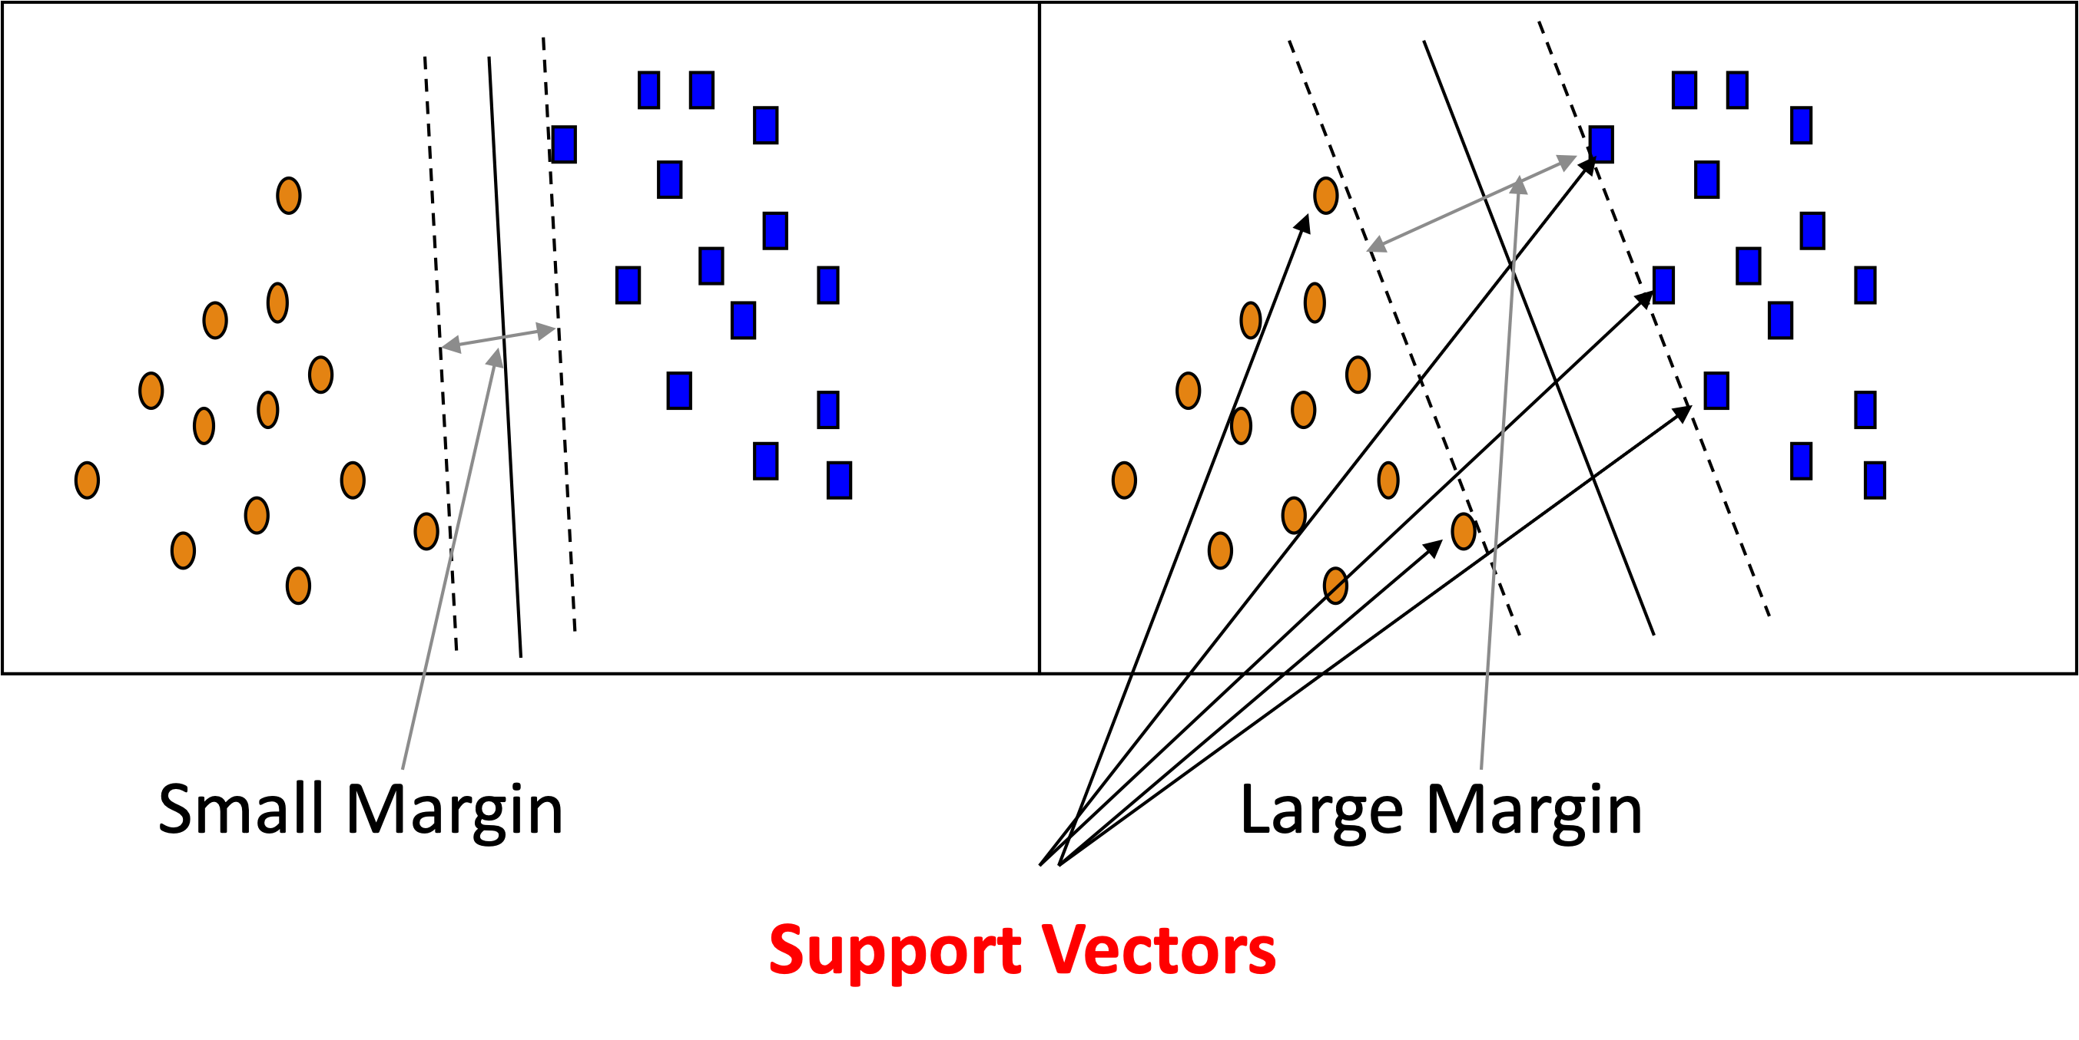
SVM: General Idea

Slide 41
SVM: Linearly Separable
A separating hyperplane can be written as
W ● X + b = 0
where W={w₁, w₂, …, w_{n}} is a weight vector and b a scalar (bias)
For 2-D, it can be written as: w₀ + w₁ x₁ + w₂ x₂ = 0
The hyperplane defining the sides of the margin:
H₁: w₀ + w₁ x₁ + w₂ x₂ ≥ 1 for y_{i} = +1, and H₂: w₀ + w₁ x₁ + w₂ x₂ ≤ – 1 for y_{i} = –1
Any training tuples that fall on hyperplanes H₁ or H₂ (i.e., the sides defining the margin) are support vectors
Constrained (convex) quadratic optimization problem.

Slide 42
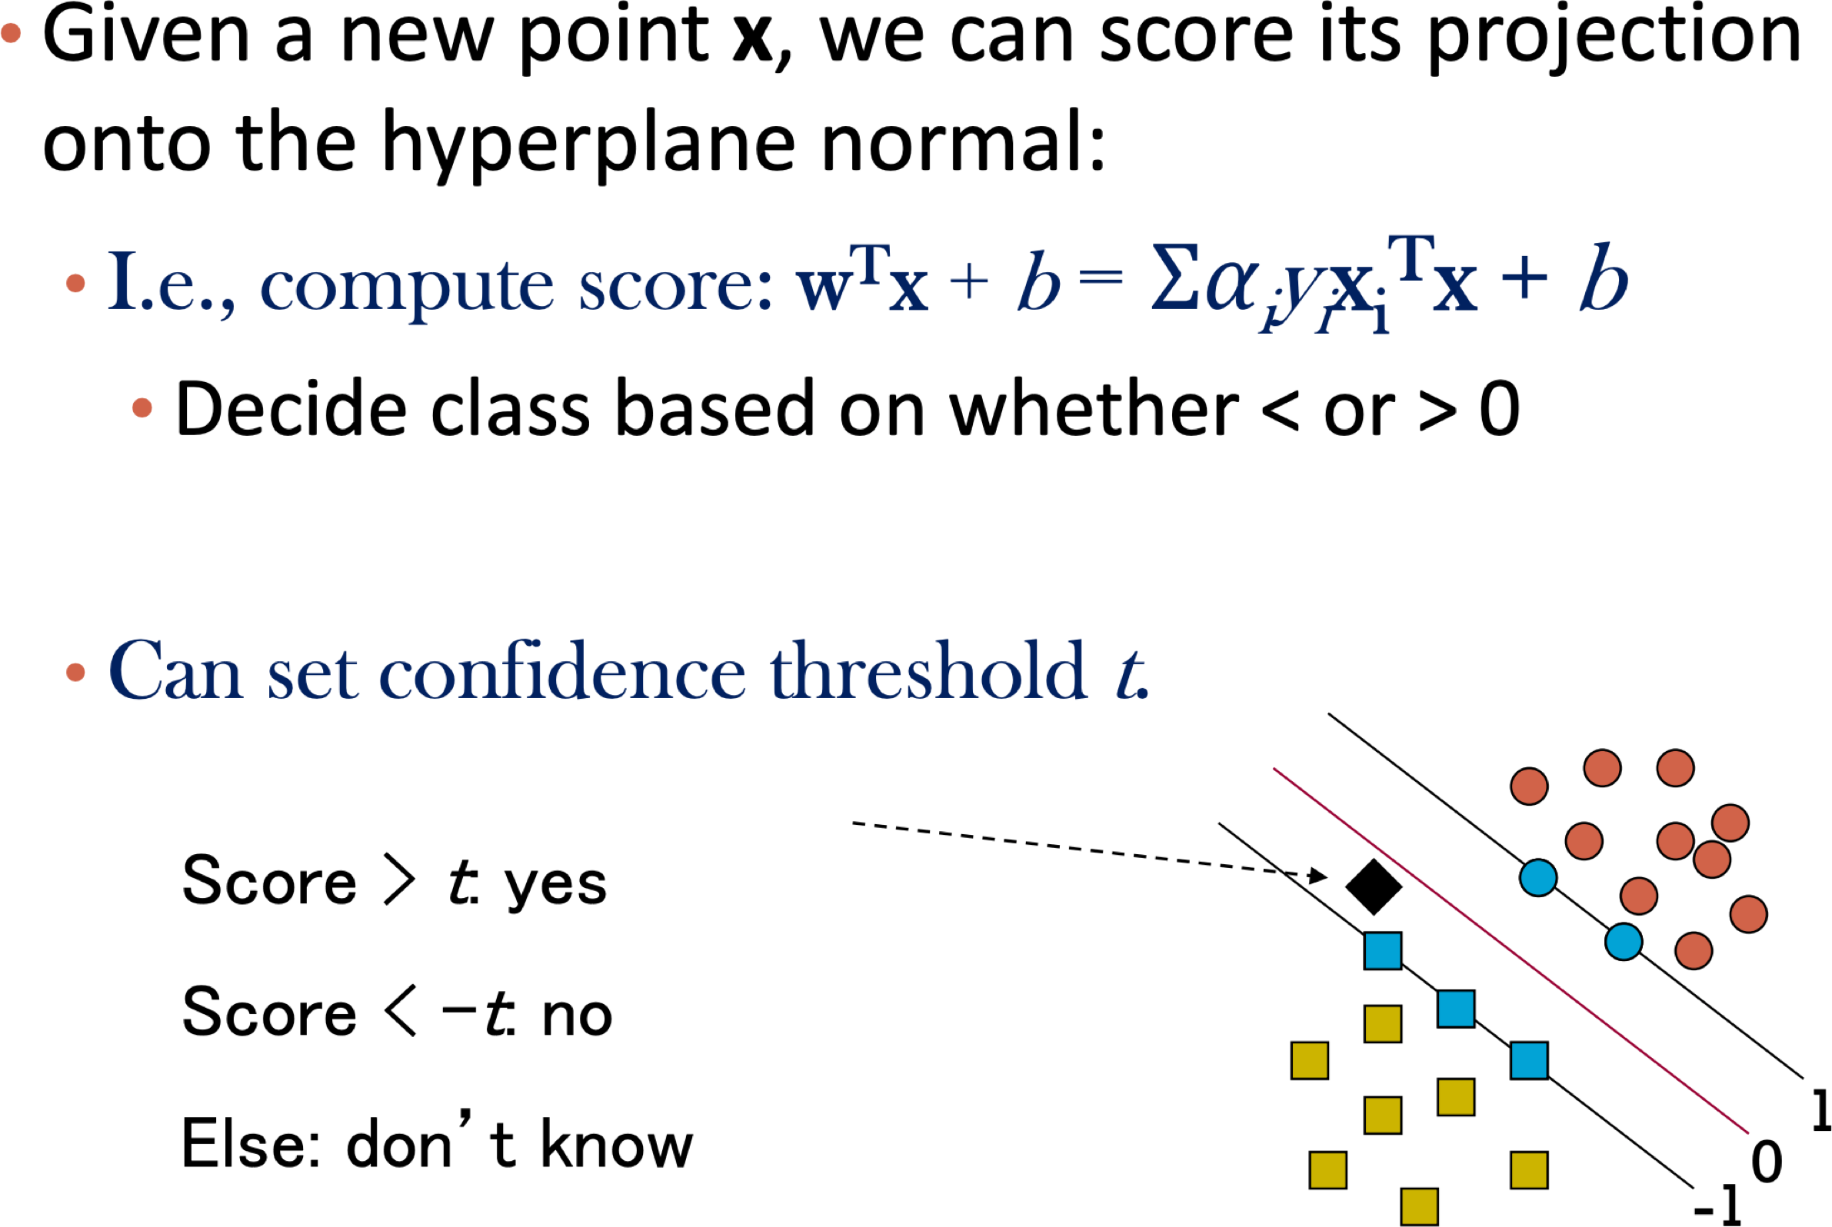
Classification with Linear SVM

Slide 43
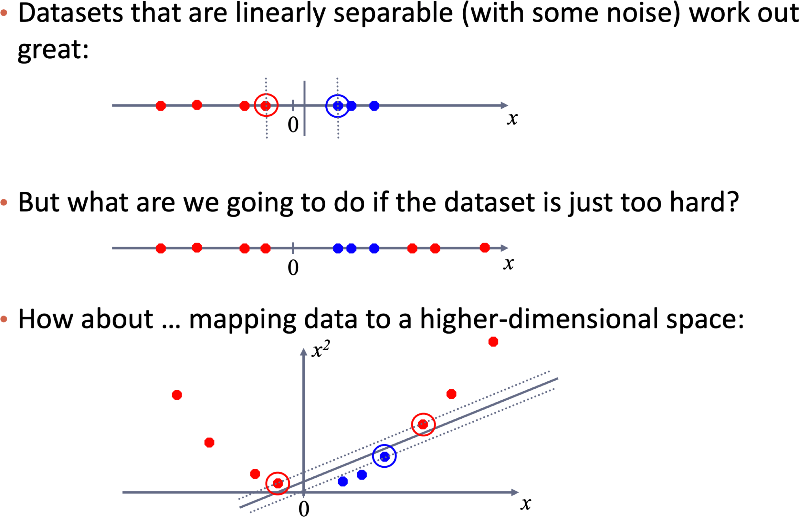
Nonlinear SVM: Motivation

Slide 44
Summary
Gradient descent
A generic algorithm to minimize objective functions
Works well as long as functions are well behaved (ie convex)
Subgradient descent can be used at points where
derivative is not defined
Choice of step size is important
Can be used to find parameters of linear models
Logistic Regression
Support Vector Machines

